Slide 1
External Tools:
Pycharm (IDE)
Anaconda (External Library Manager)
Git and Github (Consolidate work of members)
Yapf (Python code formatter)
PostgreSQL (SQL Database server software)
External Libraries/modules:
Django (Web Server)
Django-extensions (HTTPS plugin for Django)
Requests (HTTP request library)
Pillow (Image processing library)
Relevant dependencies of the four libraries specified

Slide 2
Program Flowchart

Slide 3
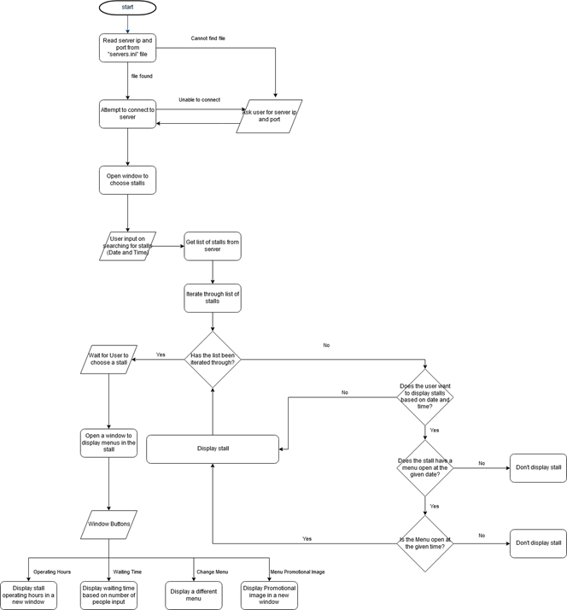

Slide 4
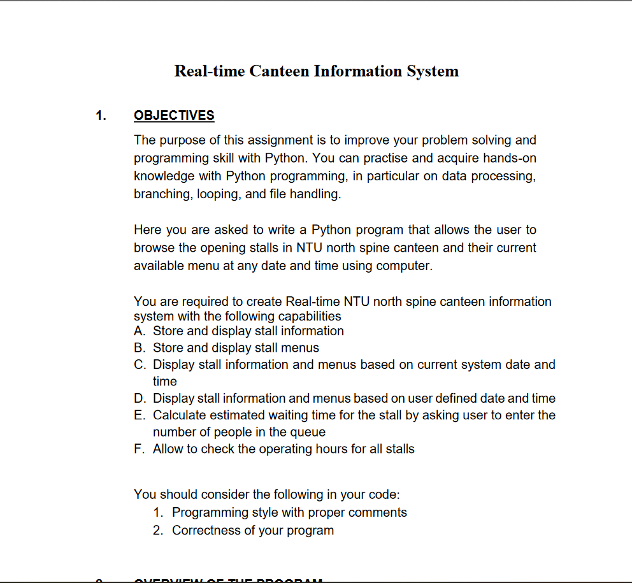
Program requirements

Slide 5
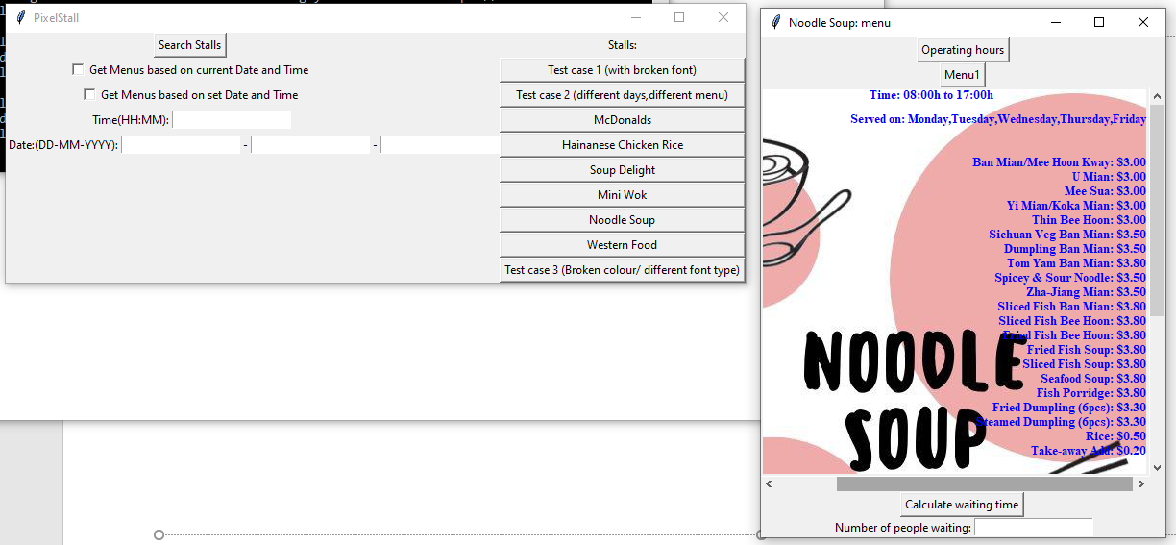
A/B:Stores and displays store menus

Slide 6
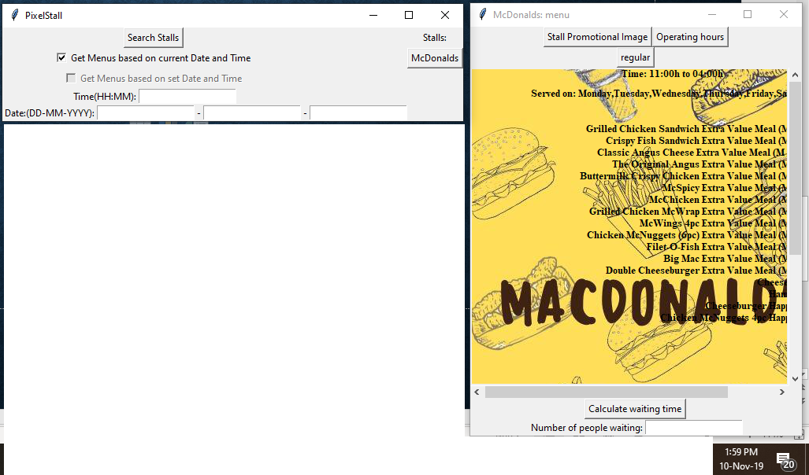
C:Display store information based on current date and time

Slide 7
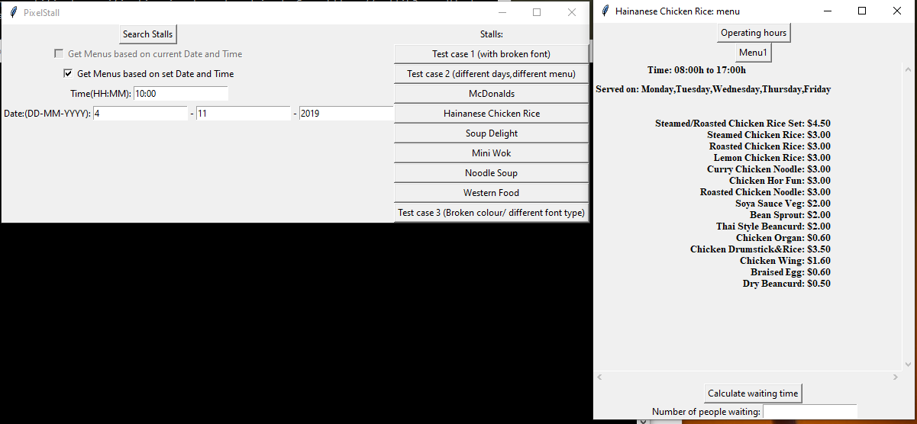
D:Display store information for user defined date and time

Slide 8
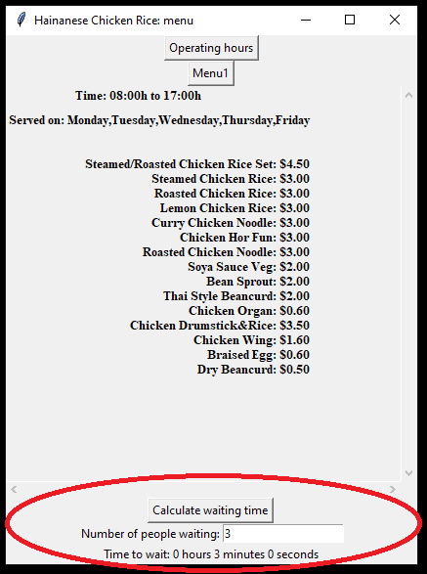
E:Calculate estimated waiting time

Slide 9
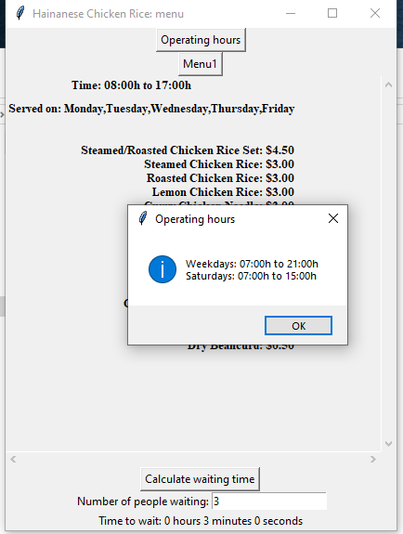
F:Check operating hours for stall

Slide 10
Extra Features:
Client/Server software design
Enables data to be changed on server without needing updates on client
Server has HTTPS support for client/server communication security
Client can connect to different server ip if needed
If there is a change in ip address of web server, update “server.ini” file on client
Different options for displaying of menu
Display menu with background
Display menu with different font size
Display menu with different font colour
All options listed above are specified in database
Error checking so that client doesn’t crash if unreadable data is loaded for display menu options
Display a promotional image for the stall if present

